Slide 1

Seventh Week of Eastertide:
Theme of the Week: Listening to God
Listening to God means being open to hearing His voice in our hearts, through prayer, Scripture, other people, and the events of daily life.
It is not always about hearing words, but about noticing the quiet guidance, peace, and encouragement that lead us towards what is good and loving.
For young people, listening to God means taking time away from distractions, trusting Him, and being willing to follow His path with courage and faith.

Slide 2
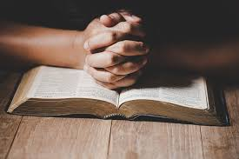
Our Morning Prayer
Monday of the Seventh week of the
Season of Eastertide
18th May
Theme of the Week:
Listening to God
Again we pray the great Easter Marian hymn to our Lady: Queen of Heaven.
L. Queen of Heaven, rejoice, alleluia.
R. For He whom you did merit to bear, alleluia.
L. Has risen, as he said, alleluia.
R. Pray for us to God, alleluia.
L. Rejoice and be glad, O Virgin Mary, alleluia.
R. For the Lord has truly risen, alleluia.
(Say together)
Let us pray. O God, who gave joy to the world through the resurrection of Thy Son, our Lord Jesus Christ, grant we beseech Thee, that through the intercession of the Virgin Mary, His Mother, we may obtain the joys of everlasting life. Through the same Christ our Lord. Amen.
1. + In the name of the Father and of the Son and of the Holy Spirit.
Amen
Let us remember we are in the presence of God.
R/ Let us adore him.
3.
St. John Baptist de La Salle Pray for us
Live Jesus in our hearts Forever

Slide 3

Our Morning Prayer
Tuesday of the Seventh Week of Eastertide
19th May
Theme of the Week:
Listening to God
(Pg 7 of your prayer book)
Hail Mary, full of Grace.
The Lord is with thee.
Blessed art thou among women and blessed is the fruit of thy womb Jesus.
Holy Mary, Mother of God.
Pray for us sinners, now and at the hour of our death
Amen
1. + In the name of the Father and of the Son and of the Holy Spirit.
Amen
Let us remember we are in the presence of God.
R/ Let us adore him.
3.
St. John Baptist de La Salle Pray for us
Live Jesus in our Hearts Forever

Slide 4
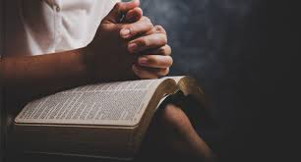
Hail, Holy Queen, Mother of Mercy,our life, our sweetness, and our hope.To thee do we cry, poor banished children of Eve.To thee do we send up our sighs,mourning and weeping in this valley of tears.Turn then, most gracious advocate,
hine eyes of mercy toward us,and after this our exile,show unto us the blessed fruit of thy womb, Jesus.O clement, O loving, O sweet Virgin Mary.
Leader: Pray for us, O Holy Mother of God.
Response: That we may be made worthy of the promises of Christ.
meditating upon these mysteries of the Most Holy Rosary of the Blessed Virgin Mary, we may imitate what they contain and obtain what they promise, through the same Christ our Lord. Amen
Our Morning Prayer
Wednesday of the Seventh Week
20th May
Theme of the Week:
Listening to God
1. + In the name of the Father and of the Son and of the Holy Spirit.
Amen
Let us remember we are in the presence of God.
R/ Let us adore him.
Let us pray:O God, whose only begotten Son, by His life, death, and resurrection, has purchased for us the rewards of eternal life, grant, we beseech Thee, that
St. John Baptist de La Salle Pray for us
Live Jesus in our Hearts Forever

Slide 5
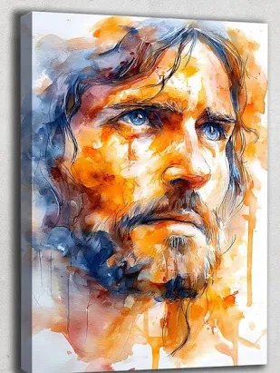
Our Morning Prayer
Thursday of the Seventh week of the season of Eastertide.
21st May
Theme for the Week:
Listening To God
Prayer for Vocations
Loving God,
help people to listen to your call in their lives.
Guide them to choose the path you have prepared for them—whether in family life, service, or following you more closely.
Give them courage to say “yes” to you, just like Mary and Saint Joseph.
Bless those who are called to serve as priests, sisters, and brothers, and help them to bring your love to others.
We ask this through Jesus Christ.
Amen.
1. + In the name of the Father and of the Son and of the Holy Spirit.
Amen
Let us remember we are in the presence of God.
R/ Let us adore him.
3
St. John Baptist de La Salle Pray for us
Live Jesus in our hearts Forever

Slide 6

Morning Prayer –
Friday of the Seventh week of the season of Eastertide.
22nd May
Theme of the Week:
Listening to God
2. When we pray, we should use the words our Lord taught us – so we have the courage to say;
(Pg 6 of our prayer book)
Our Father,
who art in heaven,
hallowed be thy name.
Thy Kingdom come,
thy will be done on earth as it is in heaven.
Give us this day our daily bread; and
forgive us our trespasses as we forgive those who trespass against us
Lead us not into temptation but deliver us from evil.
1. + In the name of the Father and of the Son and of the Holy Spirit.
Amen
Let us remember we are in the presence of God.
R/ Let us adore him.
3.
St. John Baptist de La Salle Pray for us
Live Jesus in our Hearts Forever

